Slide 1
Neuromorphic Engineering Project
Daniele D’Accolti, Valerio Ianniciello e Francesco Iberite

Slide 2
Outlines
Transduction system
Robotic finger
Acquisition protocol
Aims
MATLAB functions
Genetic algorithm for parameters
Results
Conclusions
Future developments

Slide 3
Transduction system
Sensor
Interrogator

Slide 4
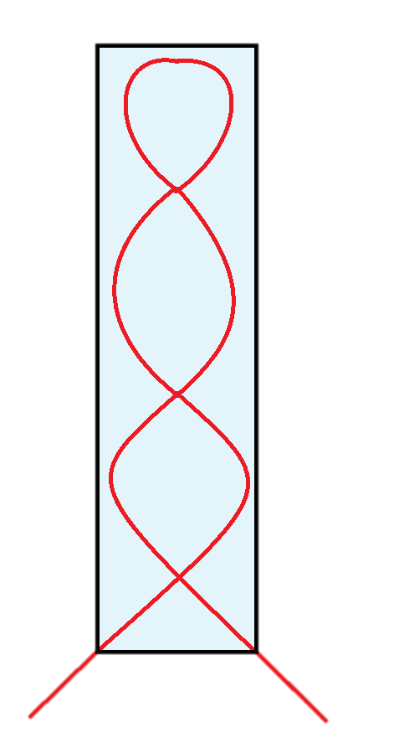
Sensor
6
7
5
8
92 mm
4
9
3
10
2
11
1
12
25 mm

Slide 5
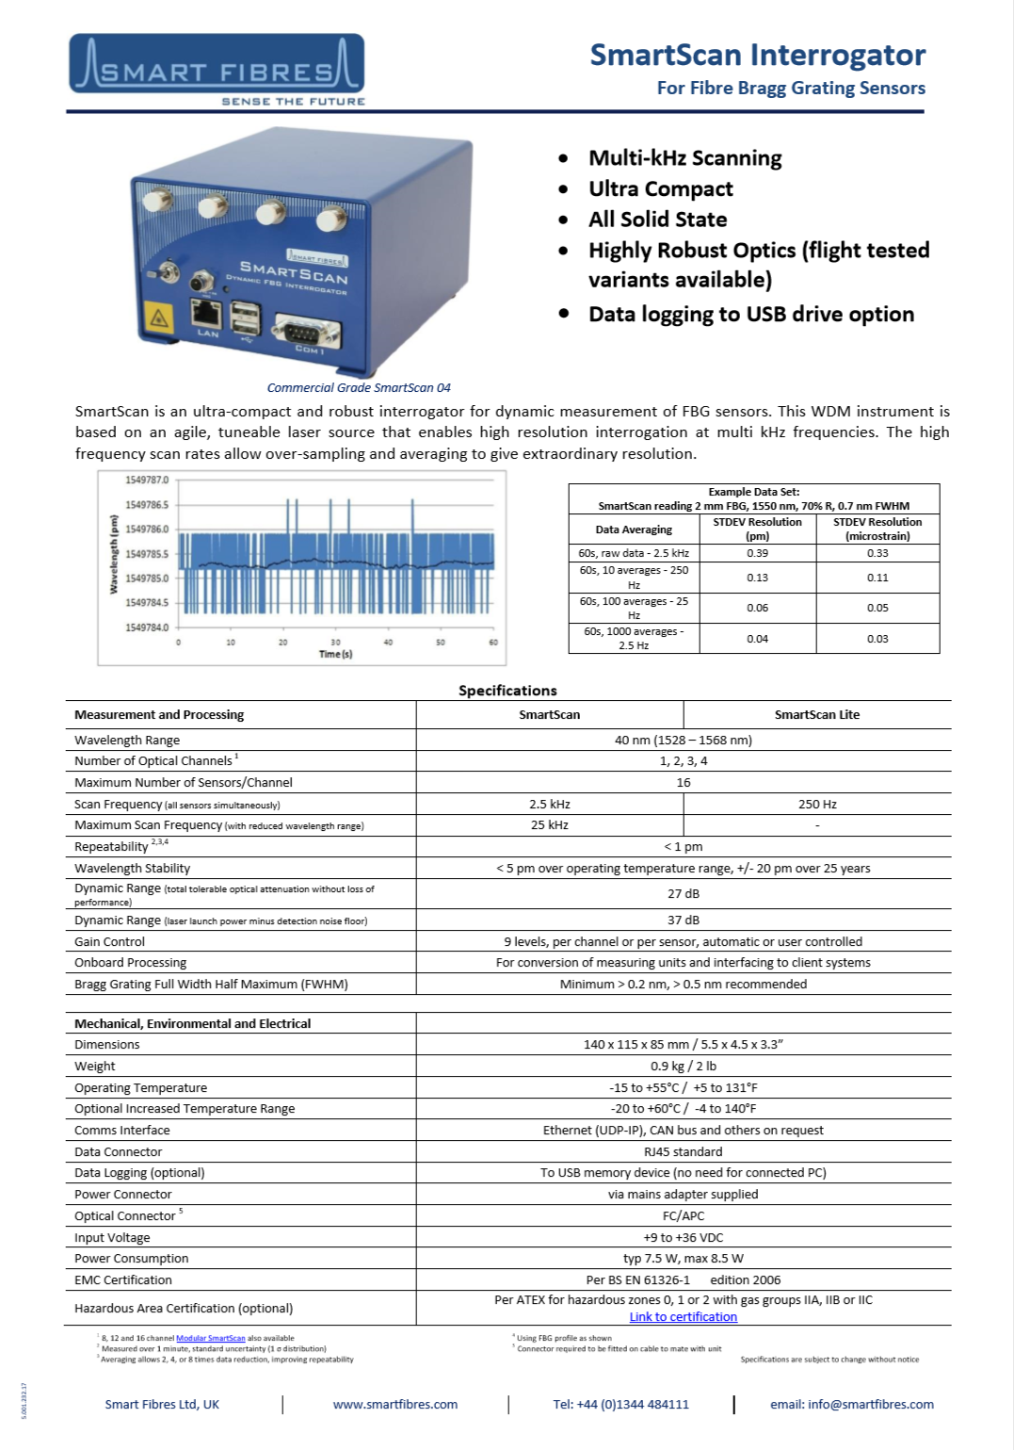
Interrogator

Slide 6
Robotic finger
The finger
Actuation system
Sensor mounting

Slide 7
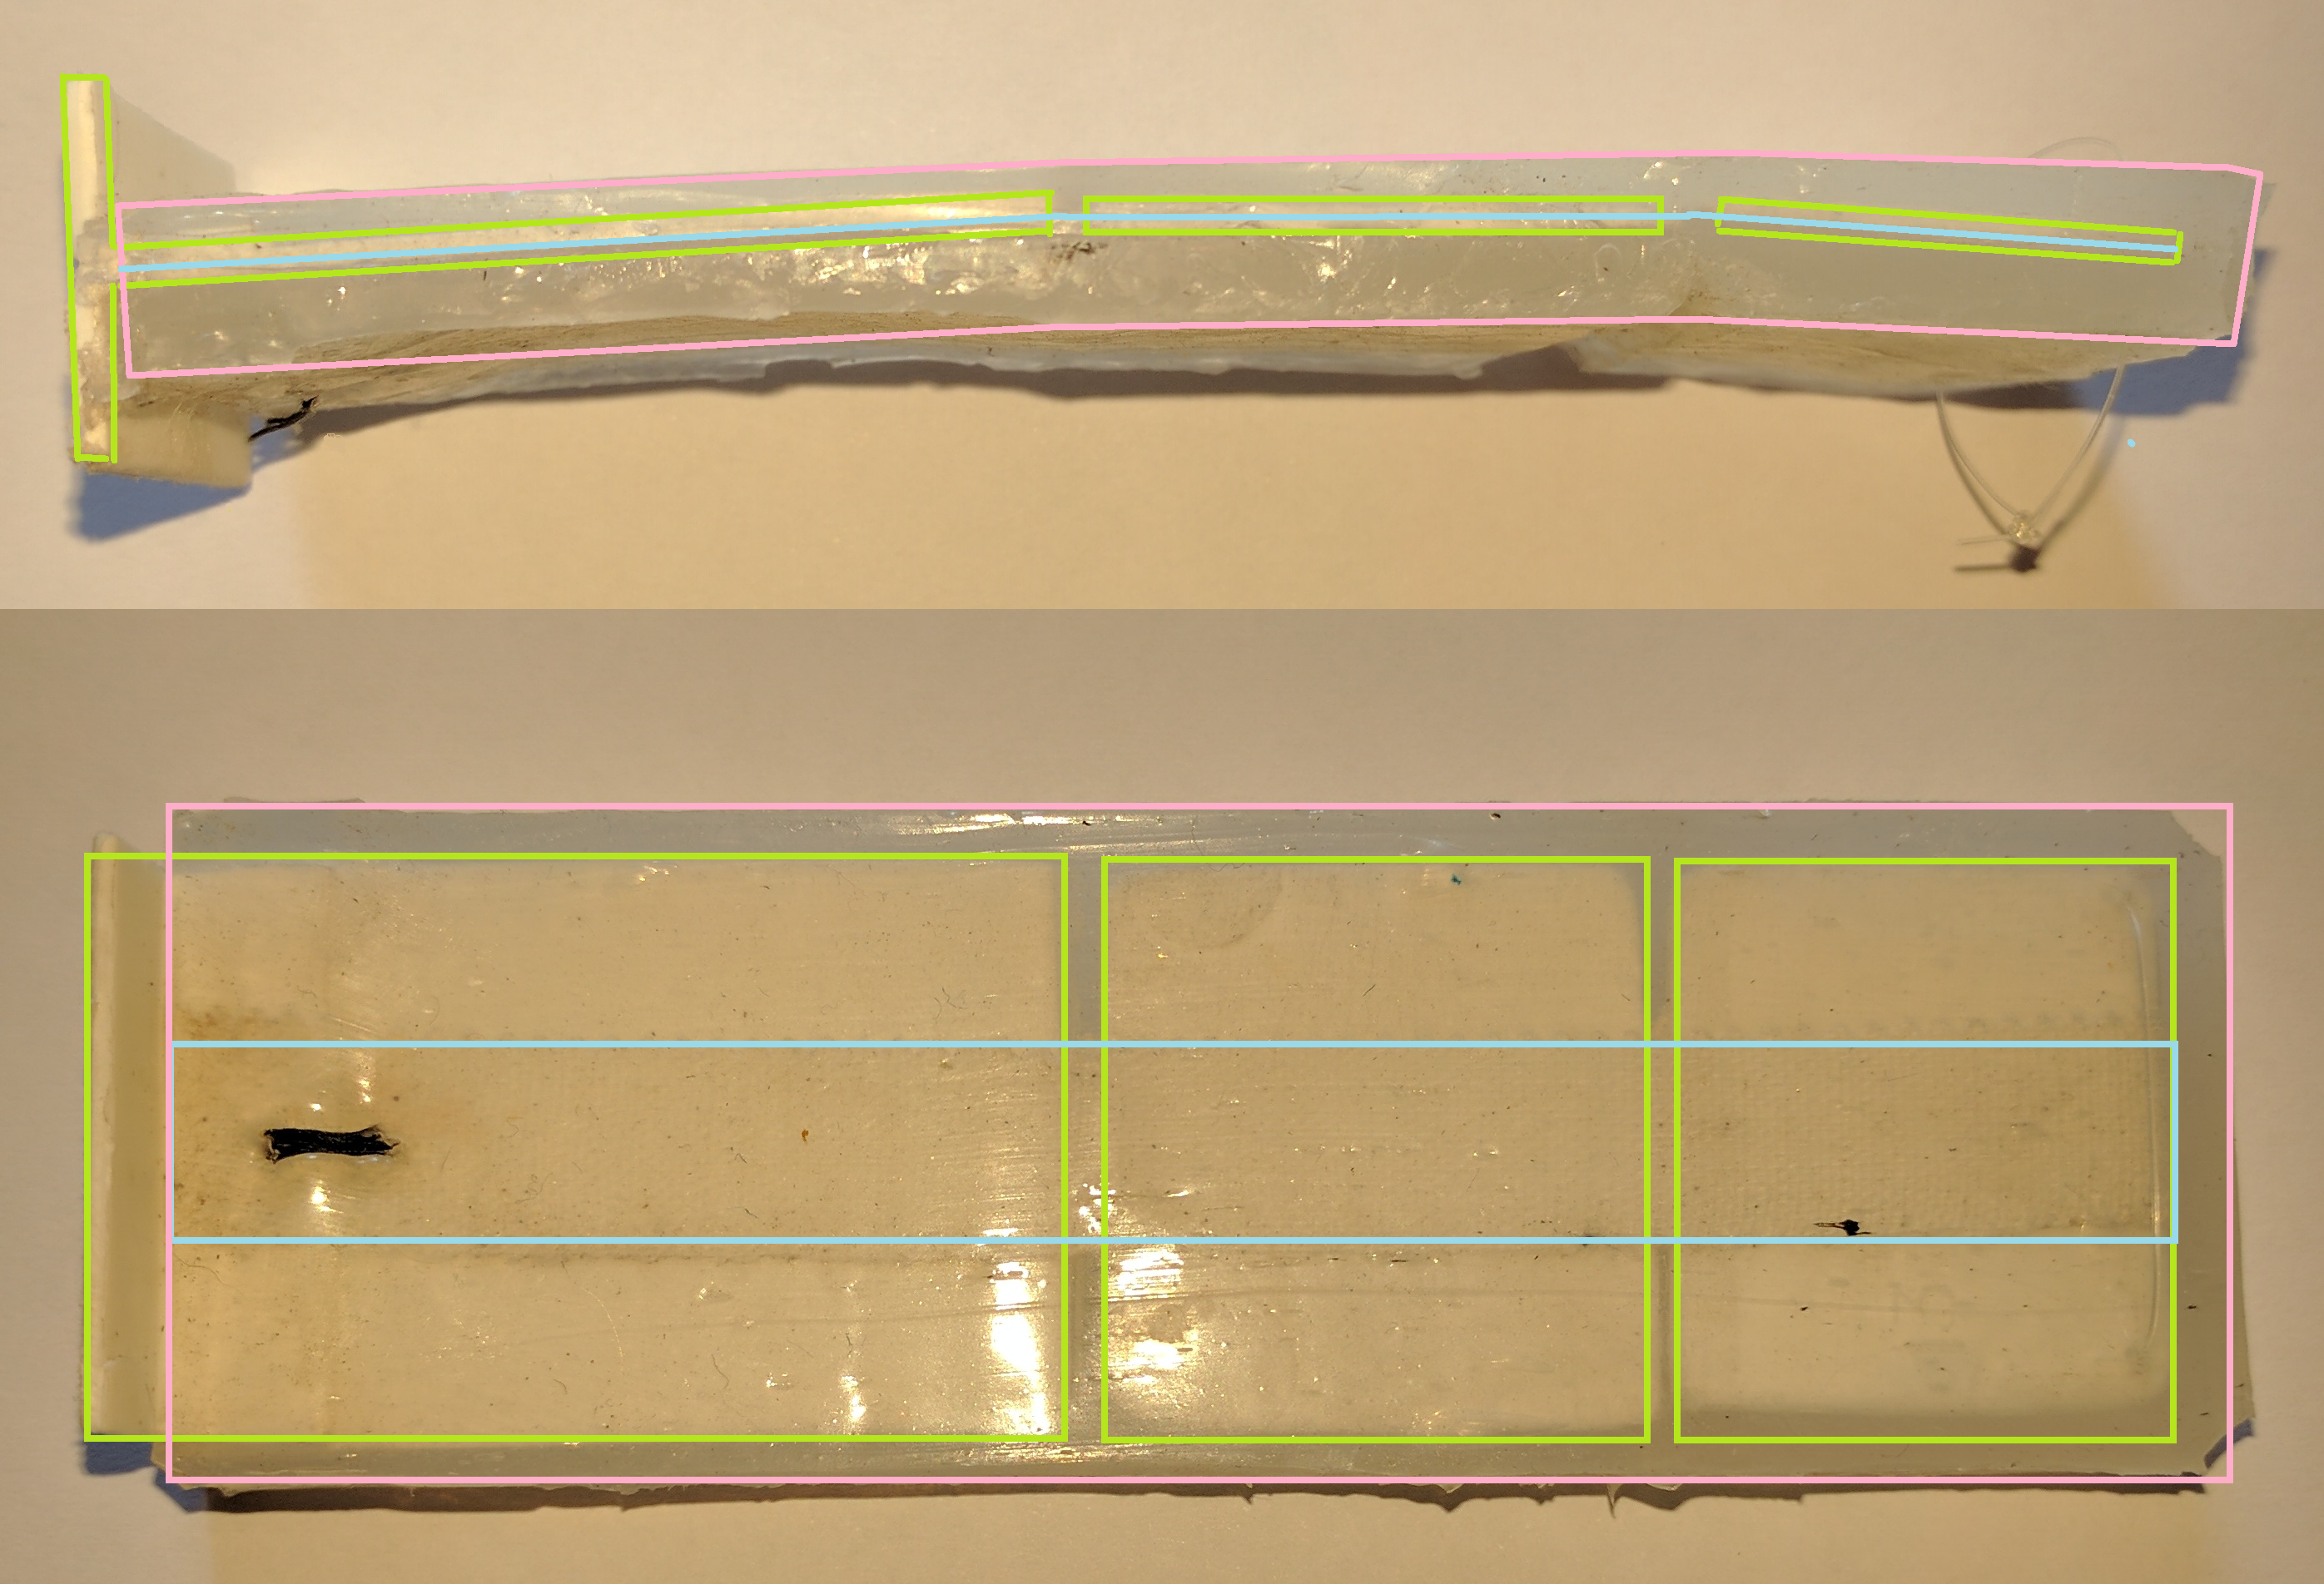
The finger
Soft tissues
Bone
Ligament

Slide 8
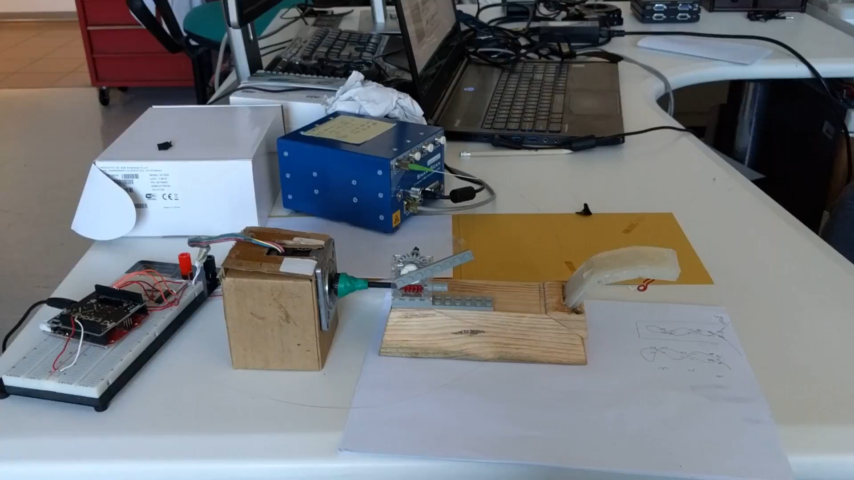
Actuation system

Slide 9
Sensor mounting
Simply glued the sensor on the finger

Slide 10
Static recordings
Acquisition protocol
19 records closing + opening
9 different positions
15 seconds per position

Slide 11
Aims
What do we want to achieve?
How do we intend to get it?

Slide 12
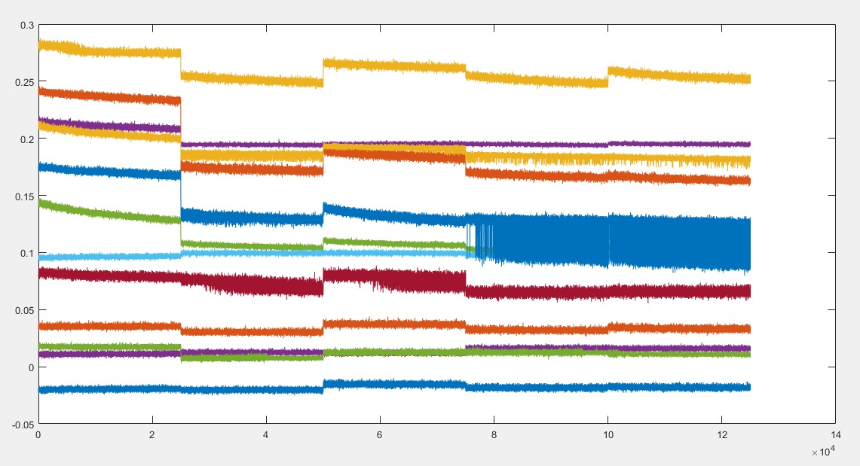
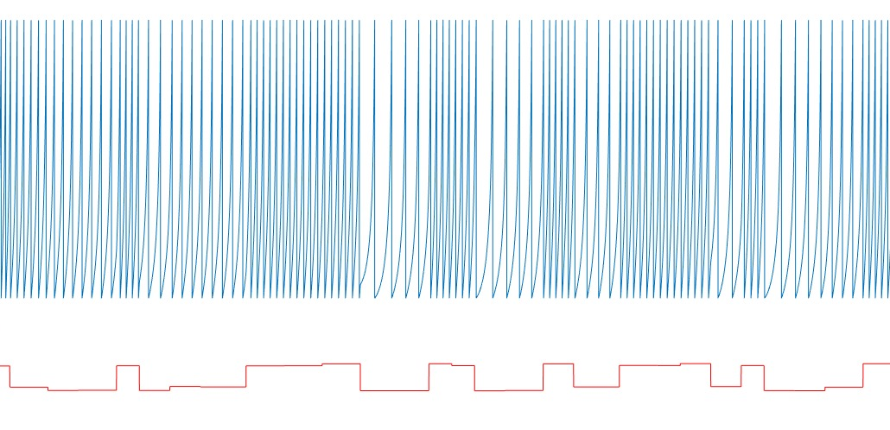
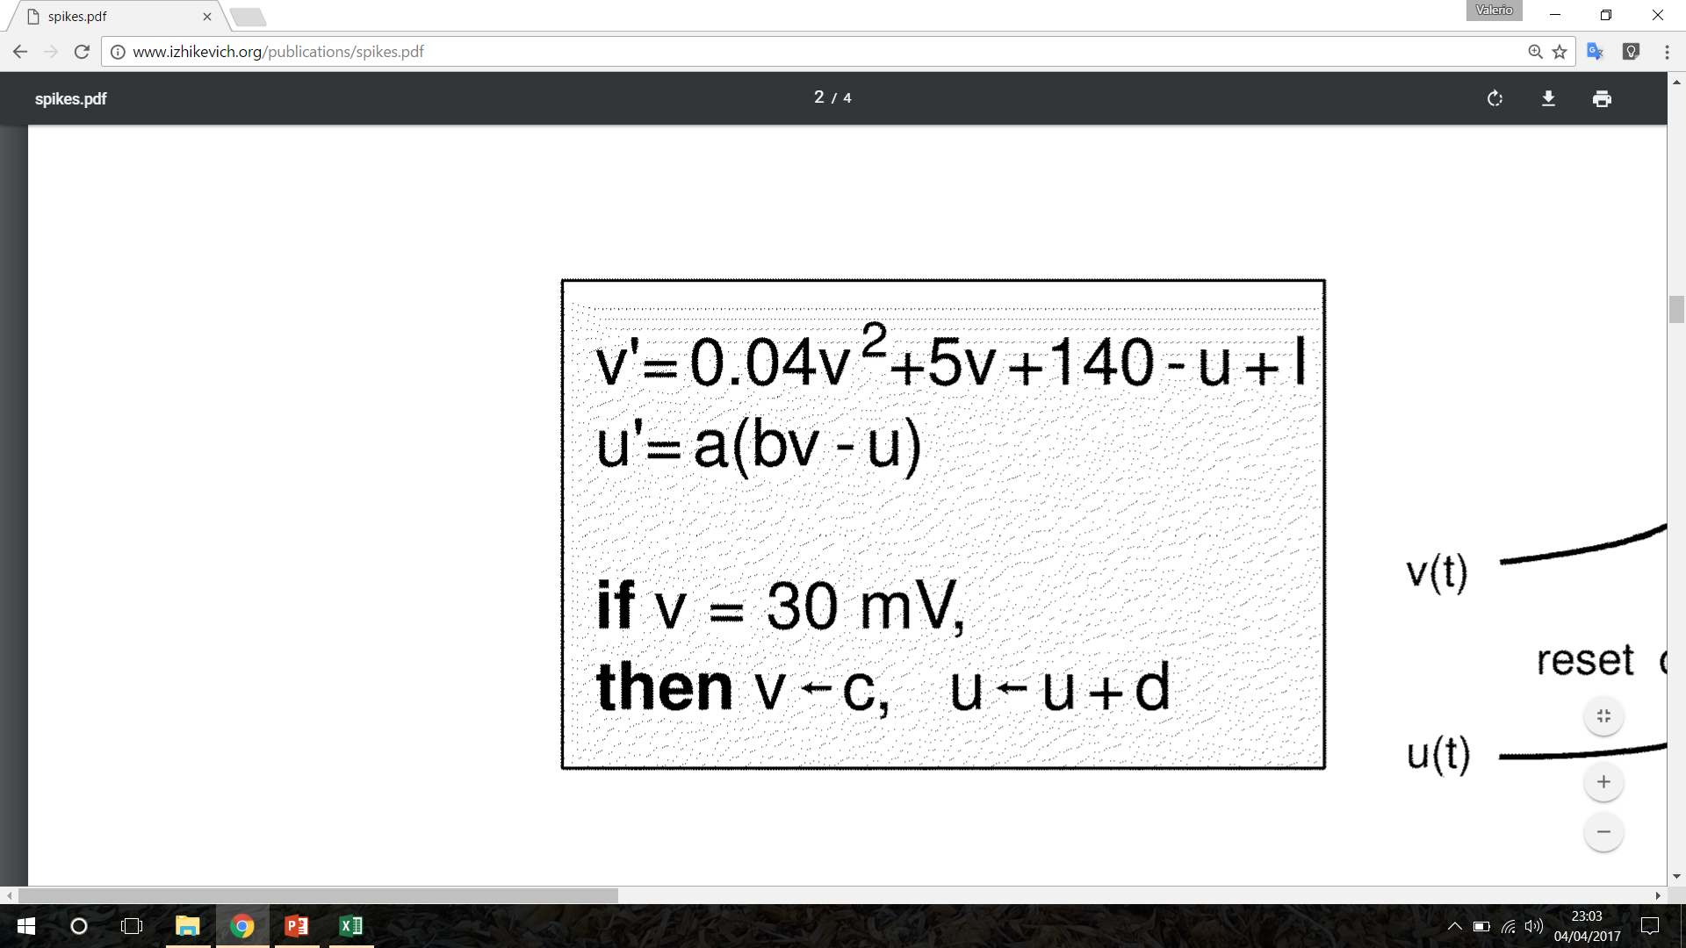
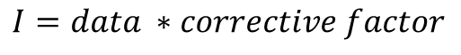
What do we want to achieve?
Izhikevich
neuron
$$I=data ∗corrective factor$$

Slide 13
MATLAB functions
CompleteWithGA_allparams.m
fit_silhouette.m
Baseline.m
Preprocessing.m
Generate_bounds.m
Split.m
Neuron.m
Metric_plot.m

Slide 14
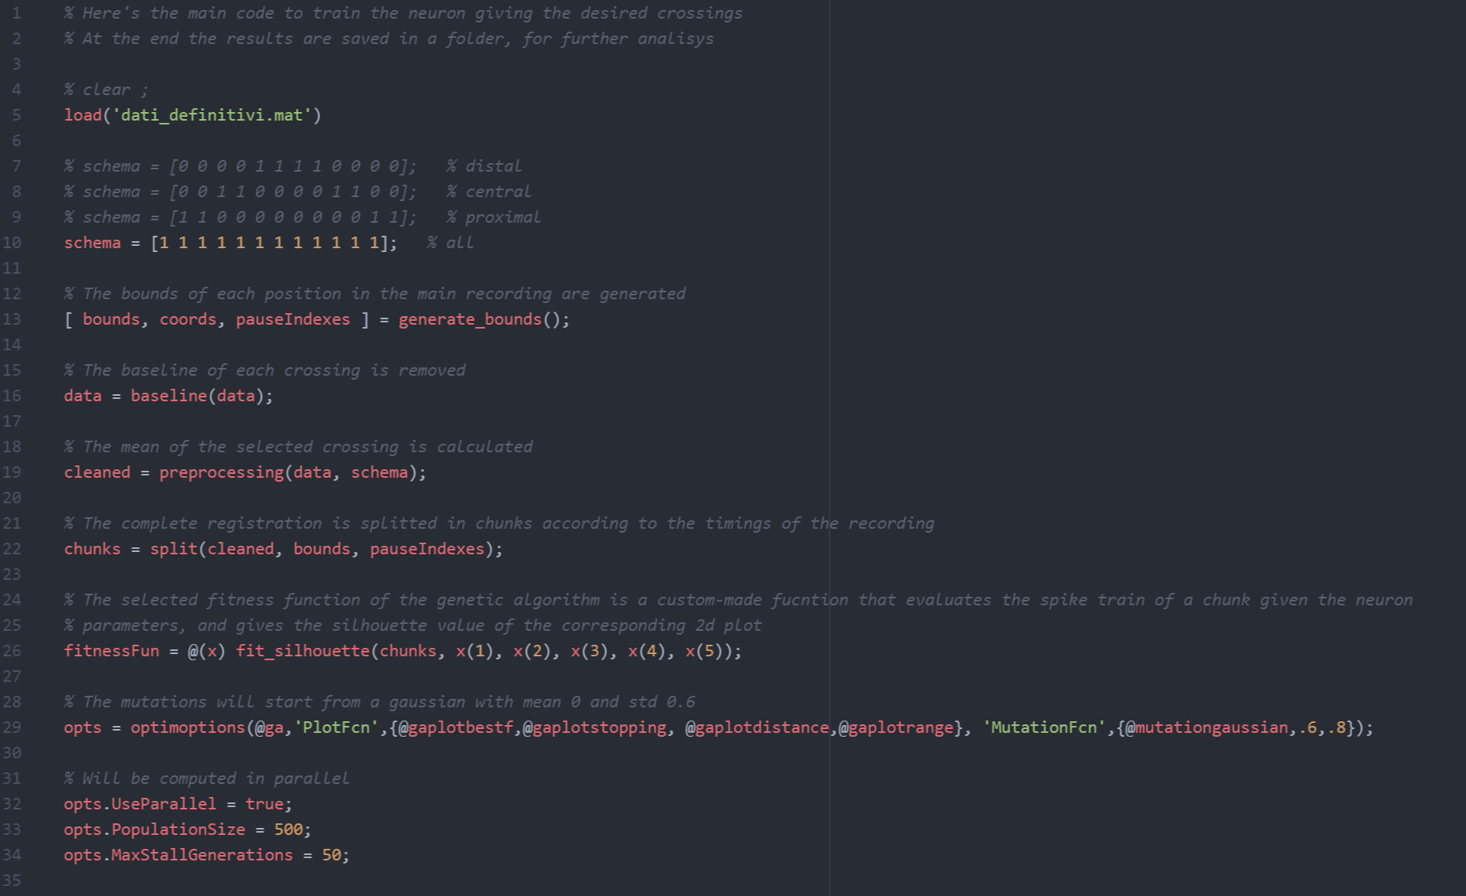
CompleteWithGA_allparams.m

Slide 15
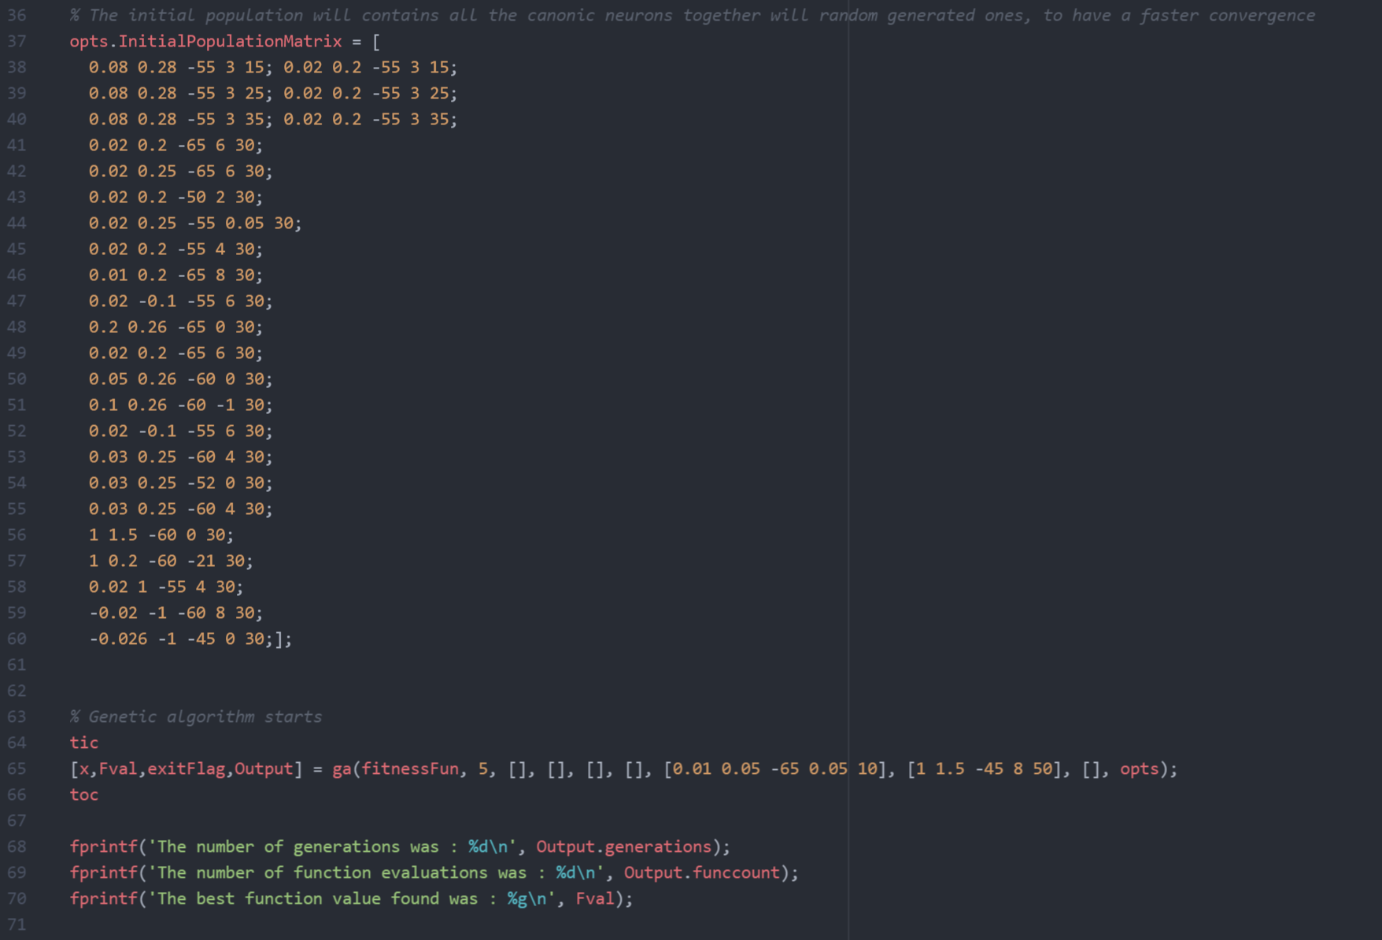
CompleteWithGA_allparams.m

Slide 16
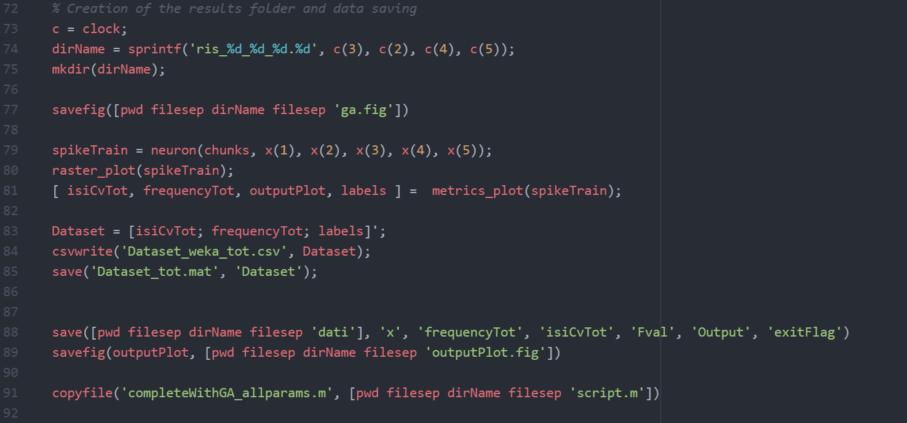
CompleteWithGA_allparams.m

Slide 17
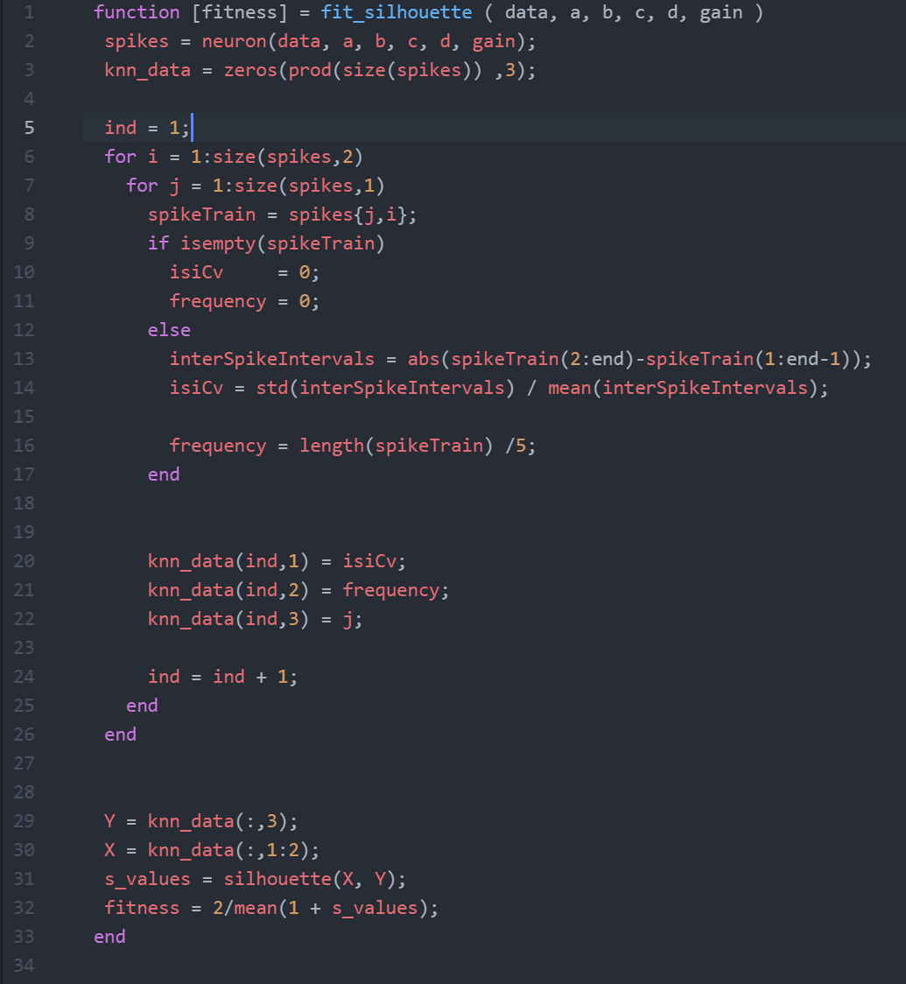
fit_silhouette.m

Slide 18
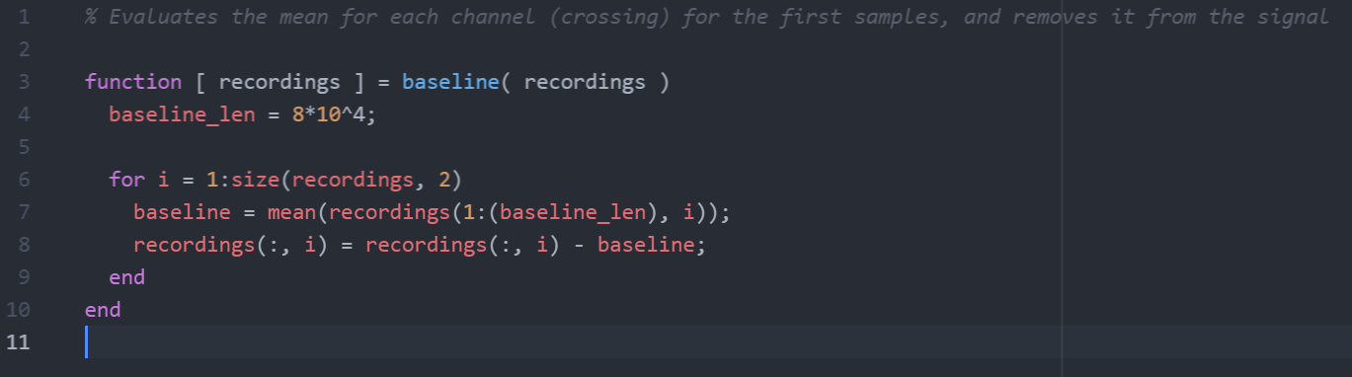
Baseline.m

Slide 19
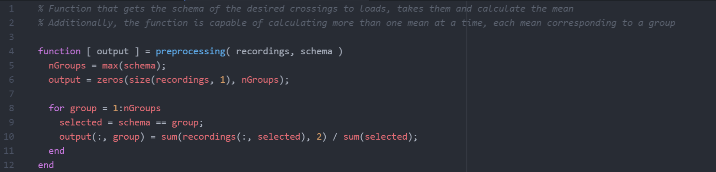
Preprocessing.m

Slide 20
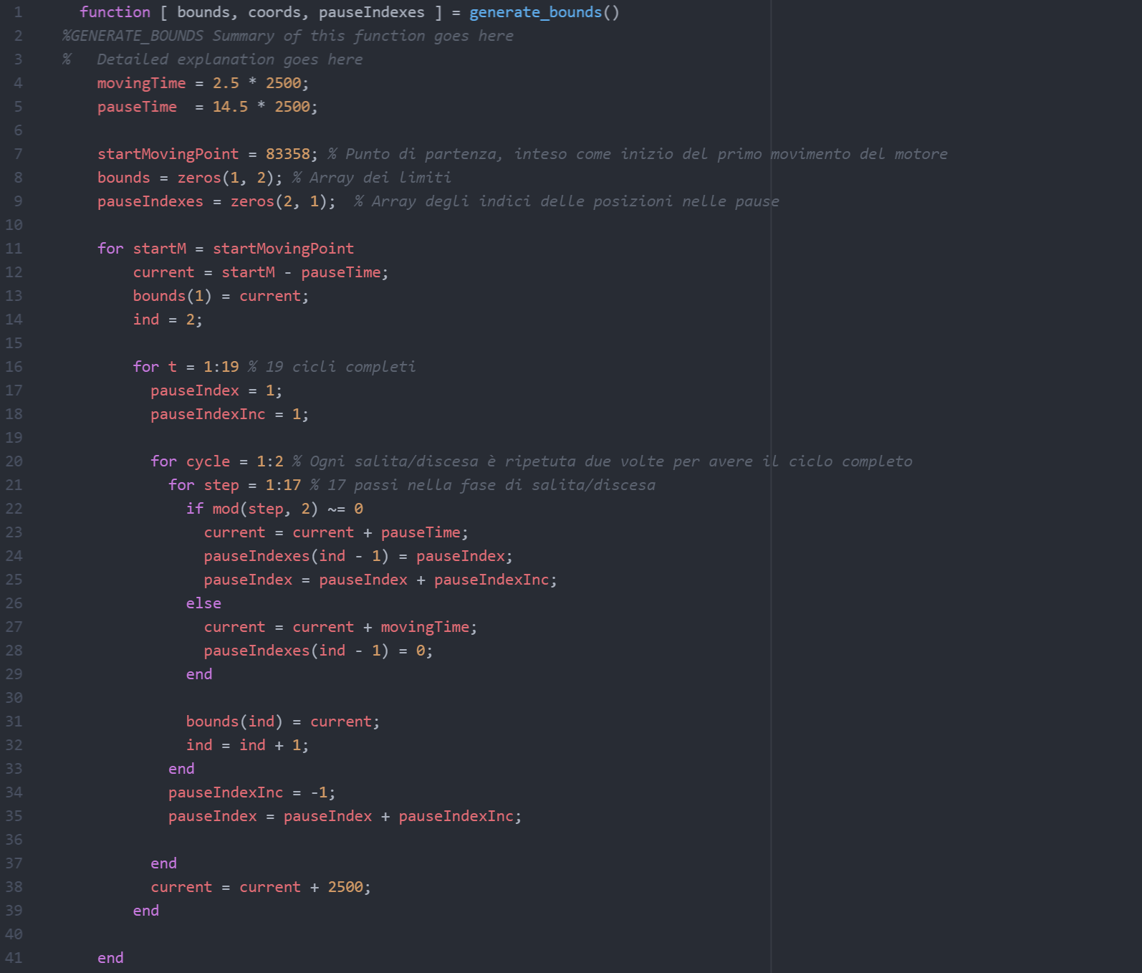
Generate_bounds.m

Slide 21
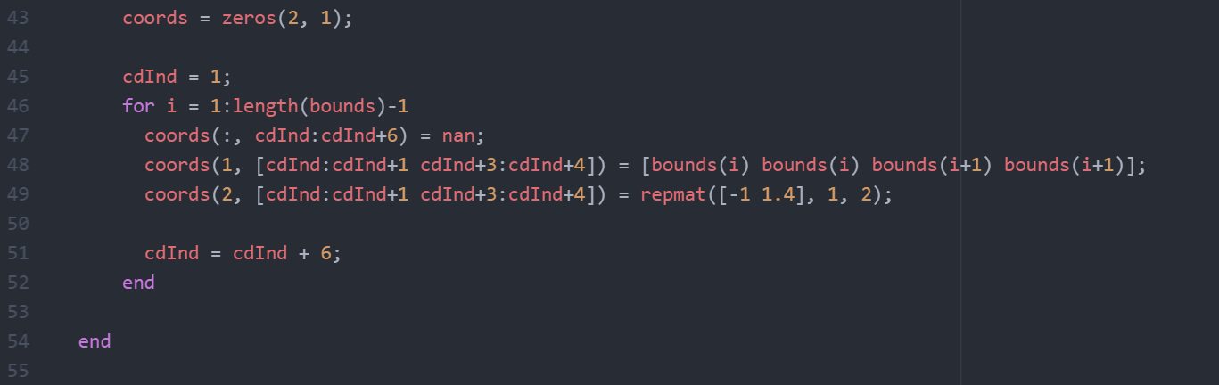
Generate_bounds.m

Slide 22
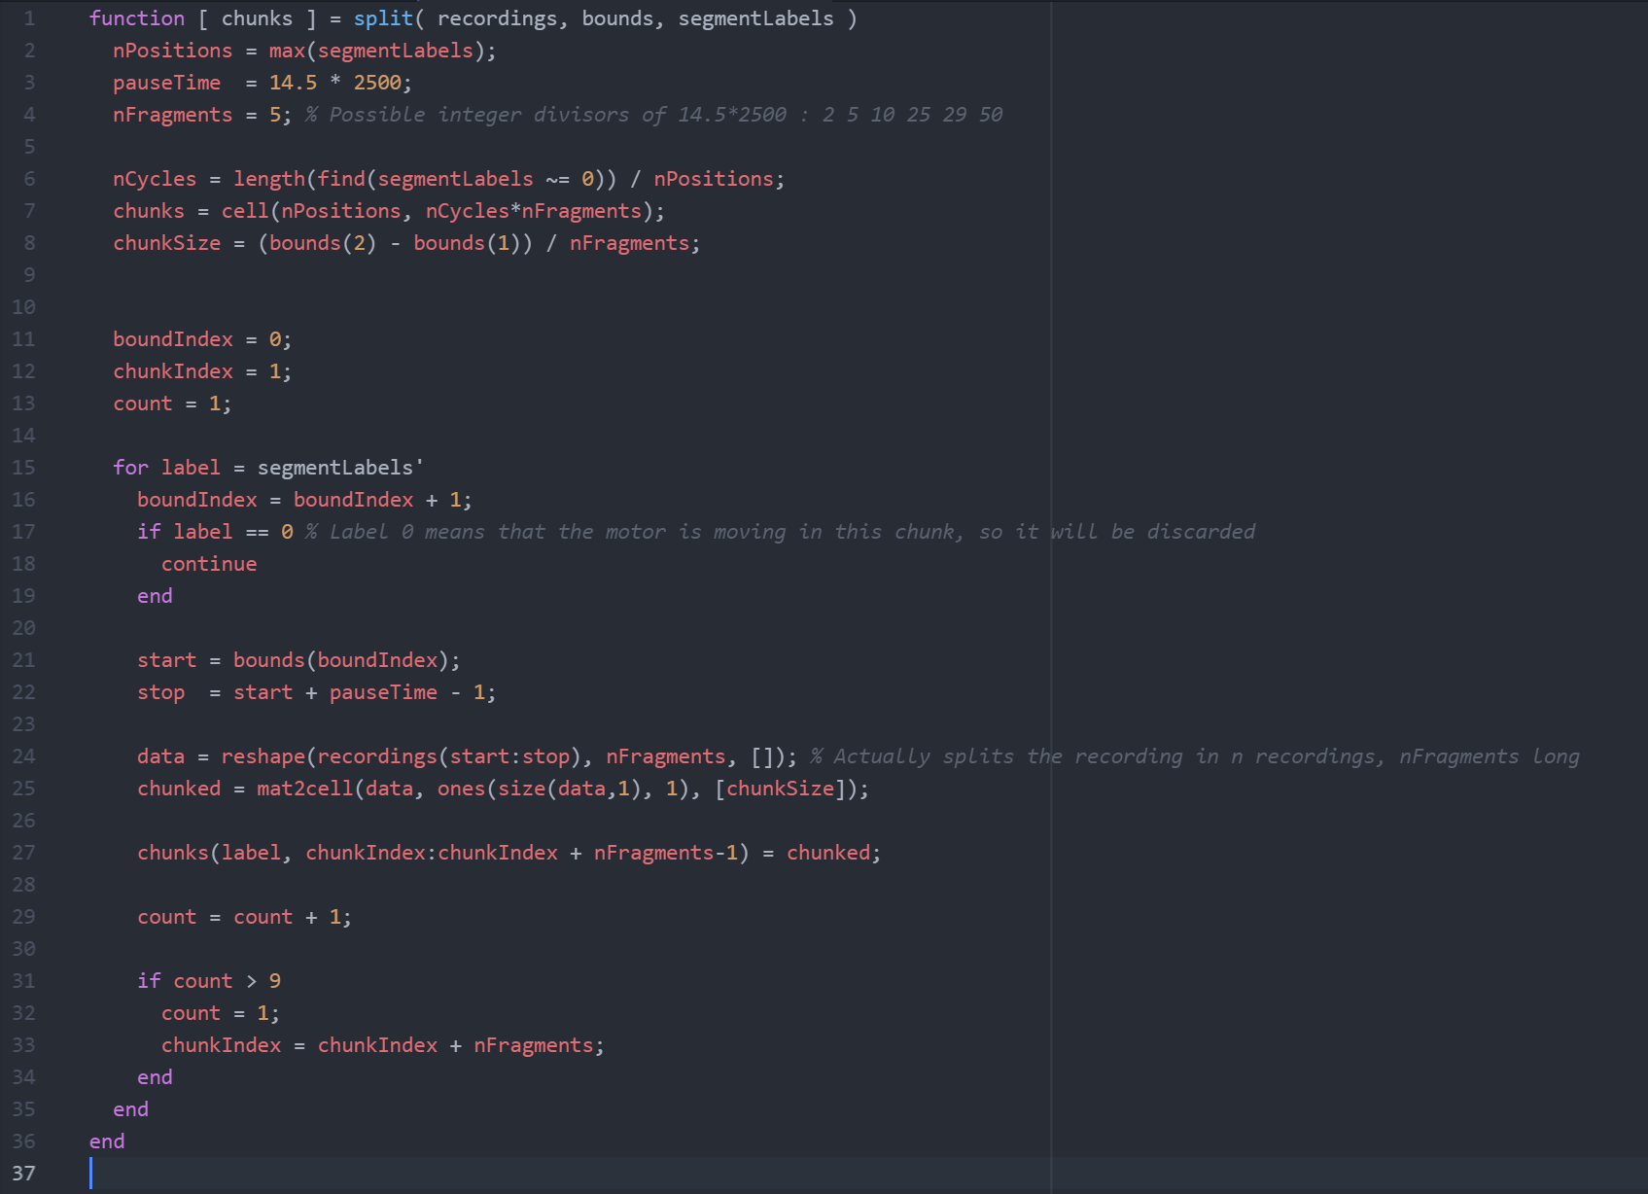
Split.m

Slide 23
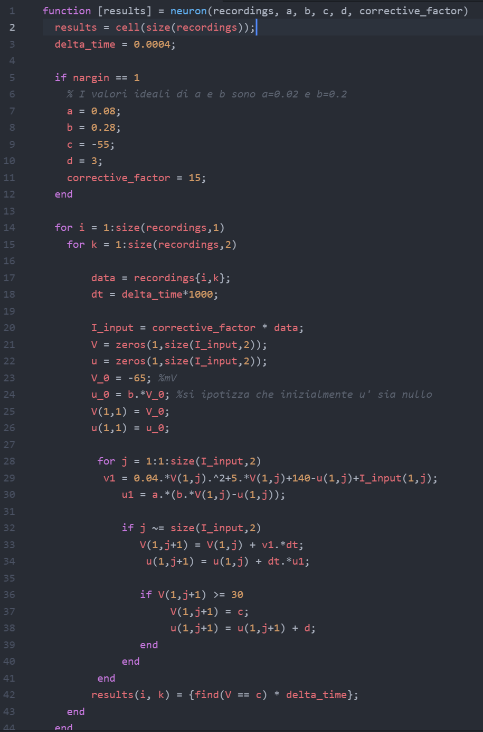
Neuron.m

Slide 24
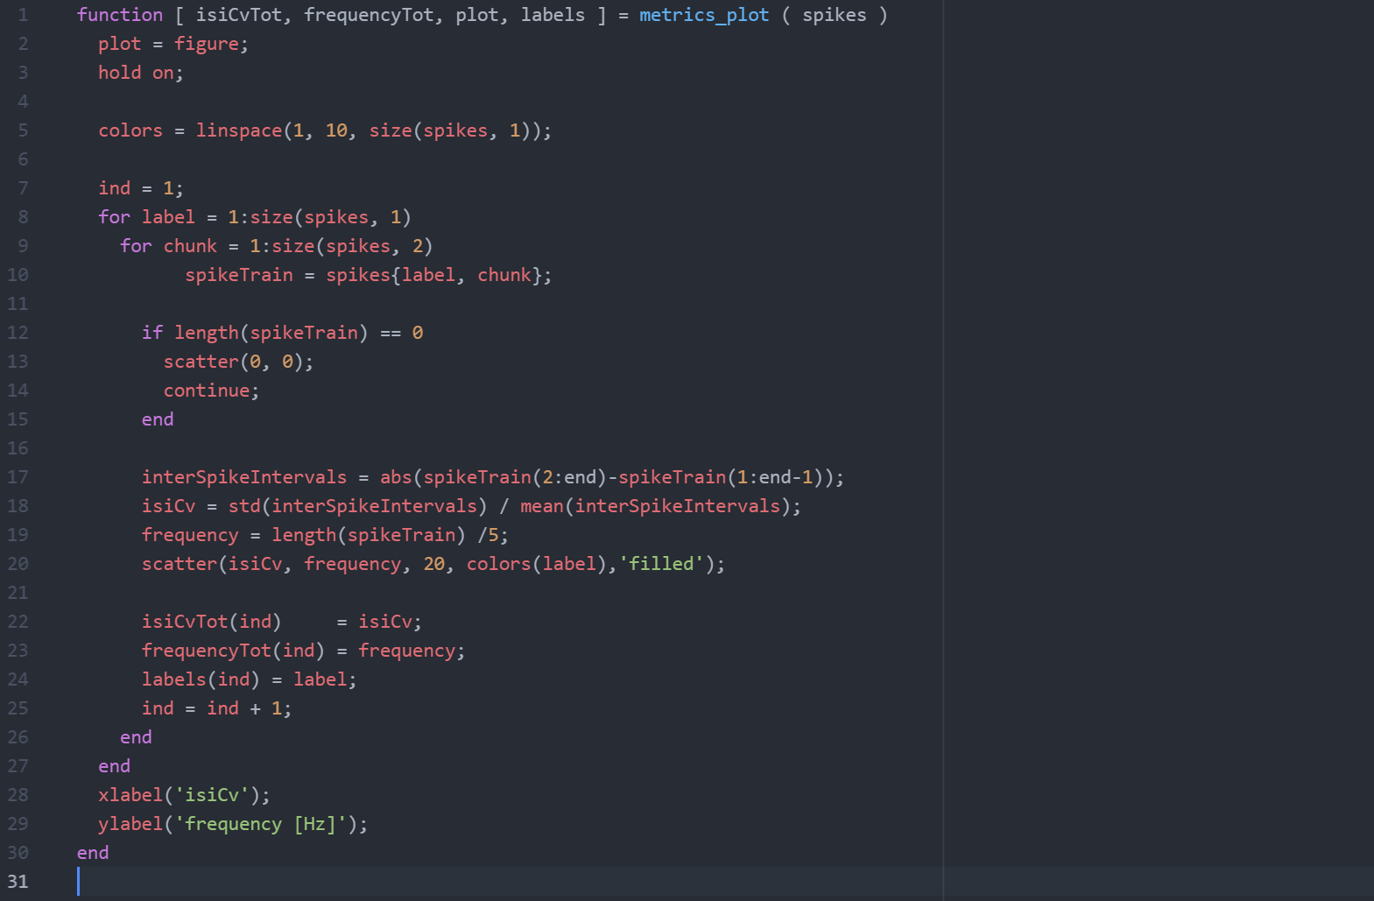
Metric_plot.m

Slide 25
Genetic algorithm for parameters
Why to use it?
Targets of the fitness function

Slide 26
Why to use it?

Slide 27
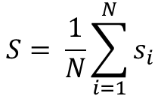
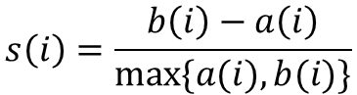
Targets of the fitness function
Minimize intragroup distance (a)
Maximize intergroup distance (b)
Silhouette function (S)
$$S= \frac{1}{N}\sum_{i=1}^{N}{s_{i}}$$
$$s\left(i\right)=\frac{b\left(i\right)−a\left(i\right)}{\max{\{a(i}),b(i)\}}$$

Slide 28
Raster plot
Optimized neuron

Slide 29
Cluster plots
Optimized neuron

Slide 30
Cluster plots
Optimized neuron
Proximal crossing
Proximal crossing
Distal crossing

Slide 31
3 neurons, only frequencies
Optimized neuron

Slide 32
Results
Features and dataset description
KNN parameters
Classification performances
Confusion matrices

Slide 33
Features and dataset description
2 datasets have been analyzed:
1 neuron, mean of all channels
3 different neurons, 1 per crossing
The following features have been extracted for every neuron:
spike rate
isiCV
The 1 neuron dataset is composed by 2 features, 1710 istances and 9 classes
The 3 neurons dataset is composed by 6 features, 1710 istances and 9 classes

Slide 34
Results KNN parameters
Neighbors

Slide 35
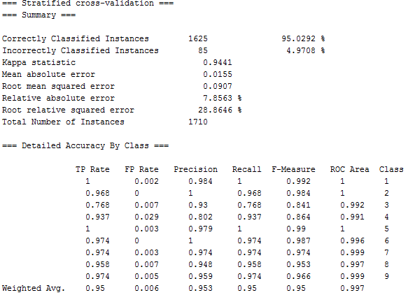
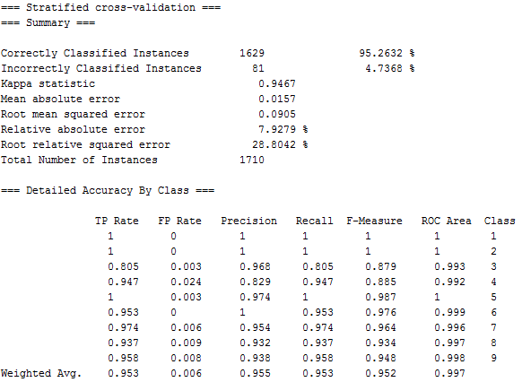
Results Classification performances 1 neuron
Frequencies + isiCV
Frequencies

Slide 36
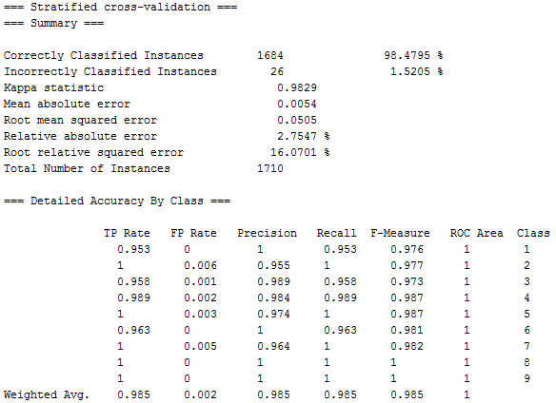
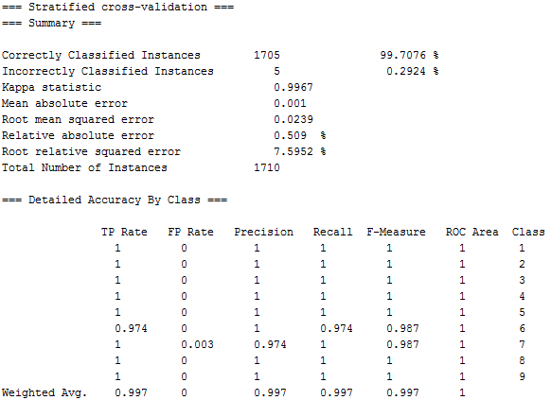
Results Classification performances 3 neurons
Frequencies + isiCV
Frequencies

Slide 37
Results Confusion matrices 1 neuron
Frequencies + isiCV
Frequencies

Slide 38
Results Confusion matrices 3 neurons
Frequencies + isiCV
Frequencies

Slide 39
Conclusions
Clusters have informative content
All the information is coded in the spike rate
IsiCV is not informative, conversely it adds noise

Slide 40
Future developments
Real-time implementation with Labview
Hardware Improvement
Improve the genetic algorithm

Slide 41
Thanks for your attention

